Slide 1








BookMyDay
Login Page
Username
Password
Remember Me
Forget Password
LOGIN
Or Sign up using
OR
SIGN UP

Slide 2
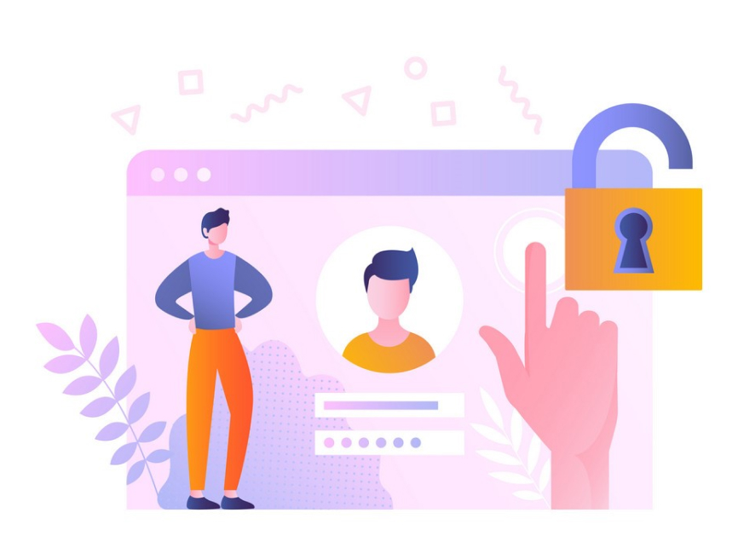

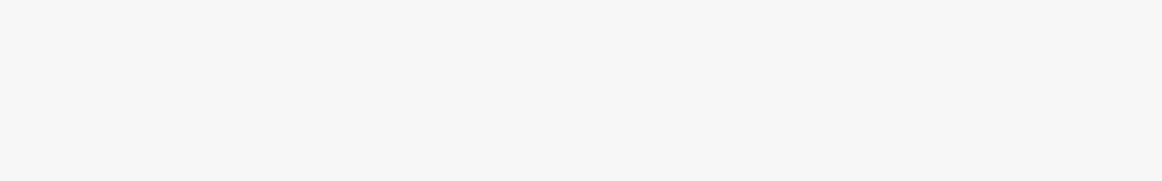
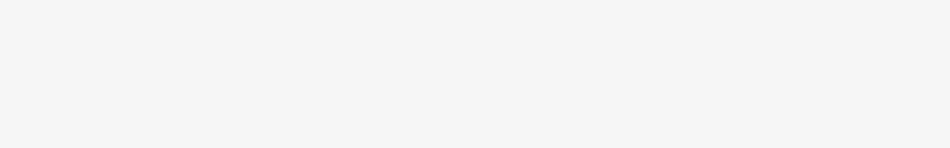

Back
Create Your Account
NAME
ENTER YOUR NAME
EMAIL
ENTER YOUR EMAIL
PASSWORD
ENTER YOUR PASSWORD
By Signing up I agree with
Terms & Conditions
SIGN UP
SIGN IN

Slide 3







Sign in
with your google account
Email or phone
Forget email ?
Not your computer ?Use Guest mode to sign in privately.
Learn more
Create account
Next

Slide 4



WELCOME
***********@gmail.com
Enter your password
Show password
Forget password ?
Not your computer ?Use Guest mode to sign in privately.
Learn more
Sign in

Slide 5
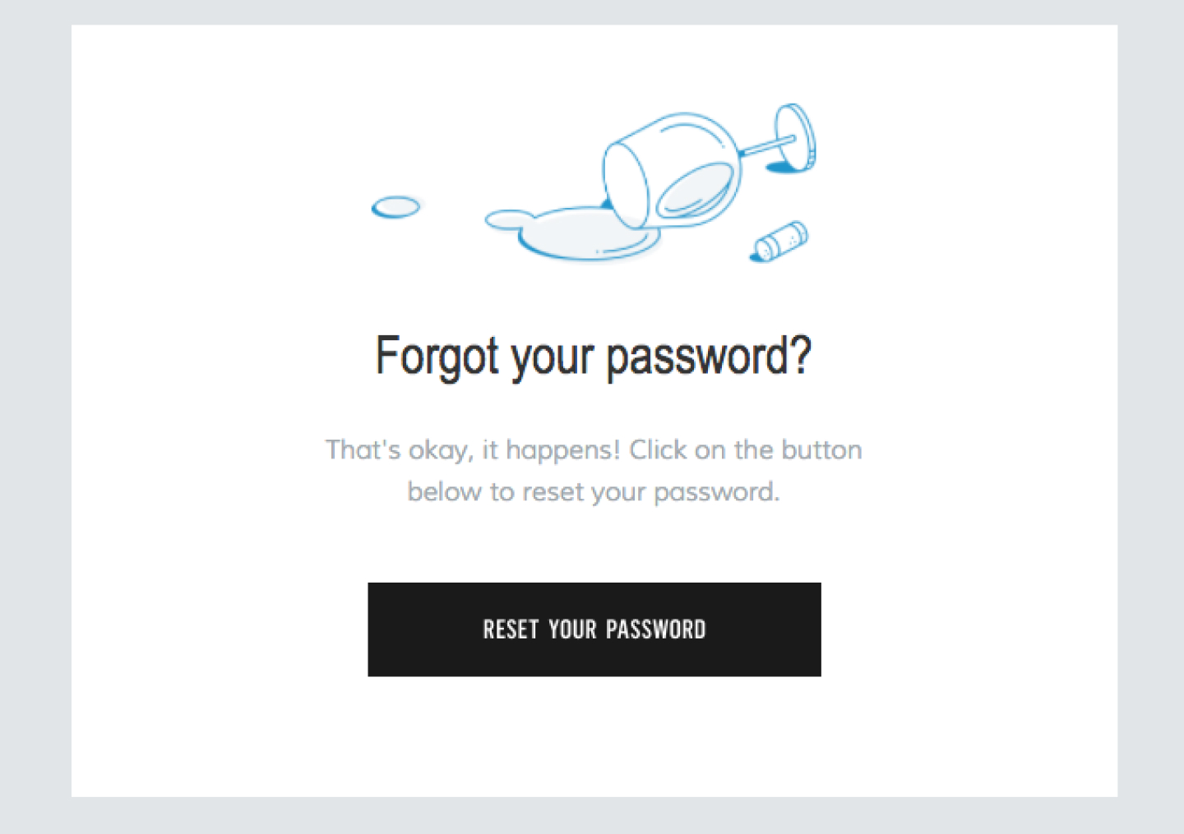




FORGET YOUR PASSWORD ?
That’s okay, it happens! Click on the button below to reset your password
RESET PASSWORD
RESET PASSWORD

Slide 6
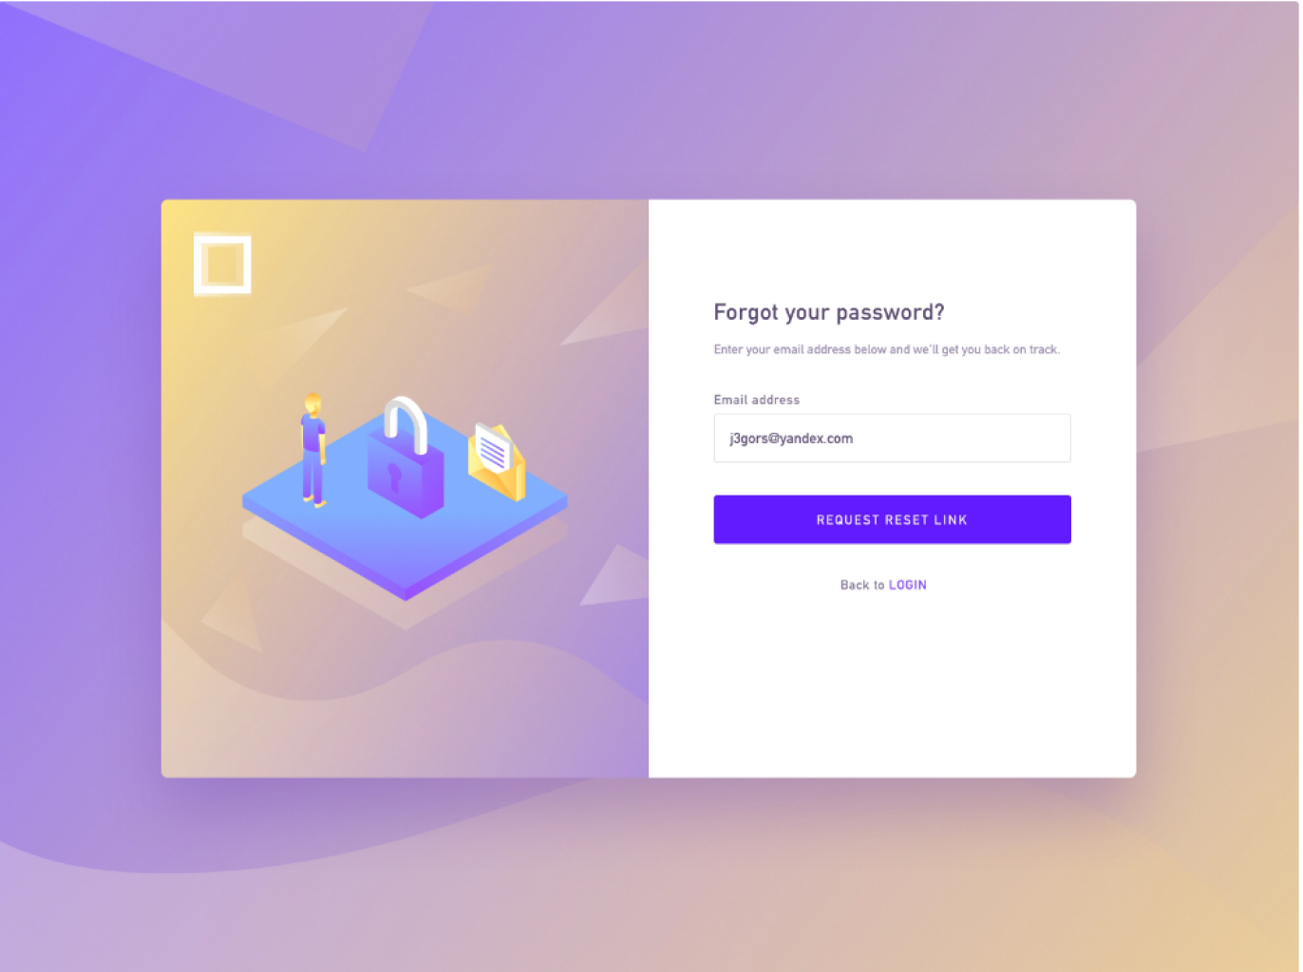





Forget Password ?
Enter your email address below and we'll get you back on track
EMAIL ADDRESS
ENTER YOUR EMAIL HERE
RESET YOUR PASSWORD
Back to
LOGIN

Slide 7
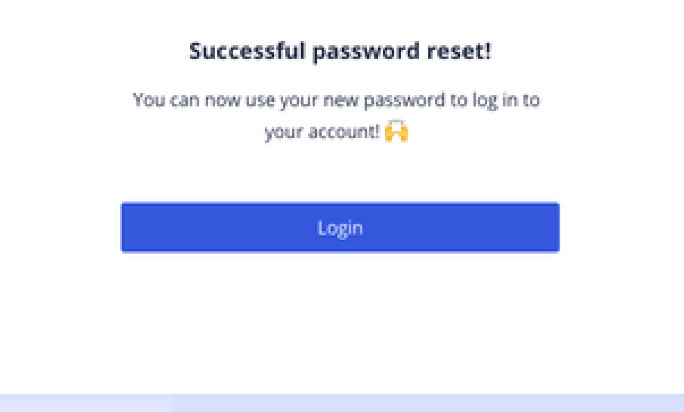



Successful Password Reset !
you can use your password to log in to your account!
BACK TO LOGIN PAGE

Slide 8
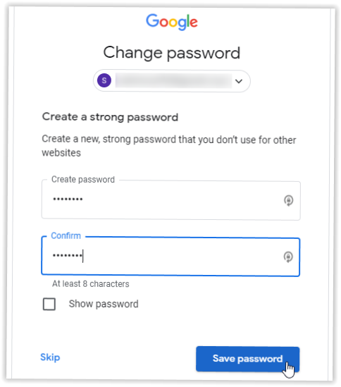







Change Password
***********@gmail.com
Create a Strong password
ENTER YOUR PASSWORD HERE
CONFIRM YOUR PASSWORD HERE
Next

Slide 9
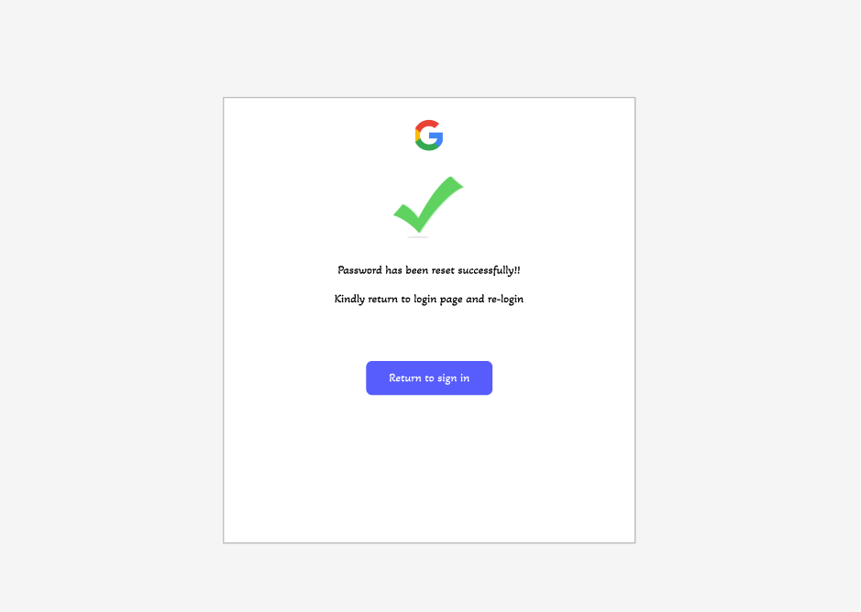

Slide 10


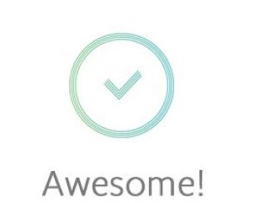

Thanks! Your account has been successfully created
GET STARTED

Slide 11
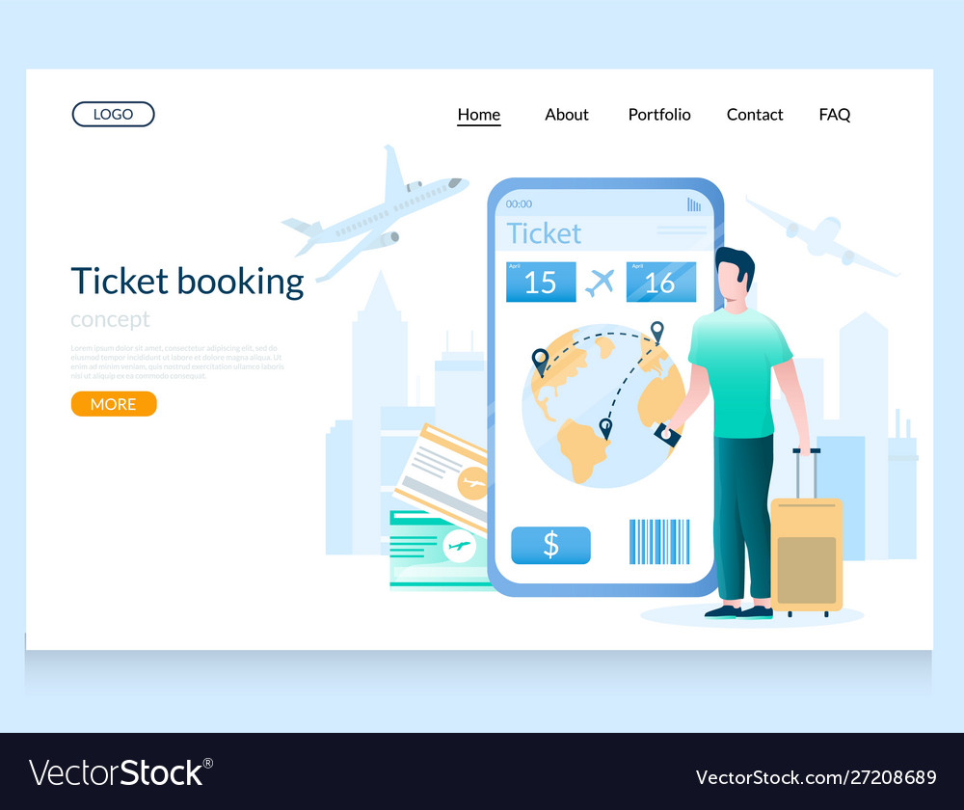

We take you where you desire
BOOK NOW

Slide 12

TO VIEW THE PRESENTATION IN FIGMA REFER THE
LINK GIVEN BELOW
Project Link : https://www.figma.com/file/LiJ60Hn8C1bsNVmEhR7QPE/Team-Project-LOGIN?node-id=0%3A1
GitHub Link : https://github.com/hari6135/BookMyDay.git

